Slide 1
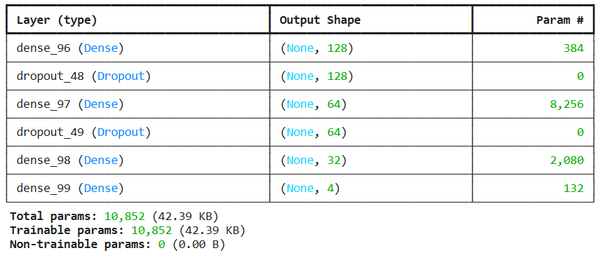
DNN model
Simple model with only three hidden layers (128, 64, 32 hidden neurons in them) with a 30% probability of random neurons being dropped.
By the end of training, the result for the test date is 95% accuracy, 0.27 loss. This is one of the highest results I have ever achieved (the maximum was 96.5%).
The reason for such a successful result is an increase in the number of epochs by 150 (with a further increase in epochs, the result usually does not improve).
Batyr Kenzheakhmetov

Slide 2
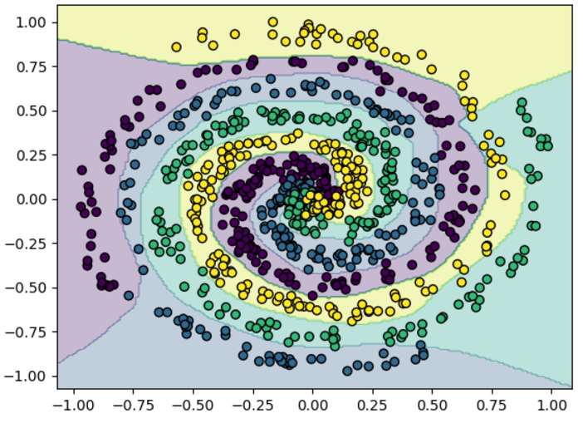
Graph of Results: DNN Model
Batyr Kenzheakhmetov

Slide 3
Using DEAP:
The hyperparameters—number of neurons, learning rate, batch size, and dropout rate—are constrained within defined ranges. Using the DEAP framework, individuals (representing hyperparameter sets) are initialized, and a population evolves over 5 generations to minimize the NN's loss. The GA employs tournament selection, blend crossover, and Gaussian mutation, with bounds enforced to keep parameters valid.
A fitness evaluation function builds and trains a Keras Sequential model based on everyone's parameters, using categorical crossentropy loss, Adam optimizer, and EarlyStopping to prevent overfitting. The loss is used as the fitness value, and accuracy is logged for analysis. Each generation logs statistics on minimum loss, average loss, maximum accuracy, and average accuracy.
Batyr Kenzheakhmetov

Slide 4
DEAP - Model
Parameters:
5 generations
50 epochs
222 neurons
learning rate 0.0090
batch size 32
dropout rate 0.0108
It gives as a performance: 95.63% accuracy and 0.1747 loss, which is not the best possible result.
Overall, during the training process, the model improved its maximum accuracy and average accuracy with each generation:
Maximum Accuracy improved steadily from 91.87% in Generation 0 to 96.88% in Generation 4.
Average Accuracy rose significantly, starting at 52.19% and reaching 86.19% in the final generation.
Batyr Kenzheakhmetov

Slide 5
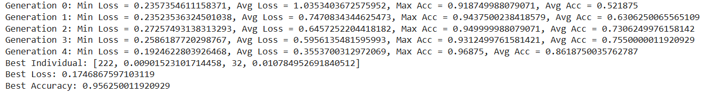
DEAP – Model Results
Batyr Kenzheakhmetov

